Slide 1
IBM University Engagement Project Submission
“Exploring the Power of Agentic AI with IBM Granite and IBM Bob”

Slide 2

Project Tile – Interview Trainer Agent
Domain of Project – Education
Student Name | Recent Passport Photo | Email ID | Mobile number [WhatsApp]
Kummari Bharath |  | bharathkummari2611@gmail.com | 9010392575

Slide 3
Problem Statement -
Problem Statement : Interview Trainer Agent
The Challenge
An Interview Trainer Agent, powered by RAG (Retrieval-Augmented Generation), prepares users for job interviews by generating tailored question sets and preparation strategies based on their profile name, experience level, and job role. It retrieves role-specific interview questions, industry expectations, behavioral scenarios, and HR guidelines from recruitment portals, professional networks, and company interview databases. Users can input their resume or job title, and the agent provides targeted questions, model answers, and improvement tips. It supports both technical and soft skill assessment, ensuring a comprehensive interview prep experience. This AI-driven assistant builds user confidence, sharpens responses, and increases success rates in competitive hiring environments.
The Objective
Build an AI-powered Interview Trainer Agent that delivers personalized interview preparation based on a candidate’s profile, experience level, resume, and target job role. The solution should:
Personalized Interview Preparation – Generate tailored interview questions based on the candidate’s profile and job role.
RAG-Based Retrieval – Retrieve role-specific questions, industry expectations, behavioural scenarios, and HR guidelines from relevant knowledge sources.
Technical & Soft Skills Assessment – Evaluate both technical knowledge and communication/behavioural skills.
Model Answers & Feedback – Provide suitable model answers, identify weaknesses, and give actionable improvement tips.
Adaptive Interview Experience – Dynamically adjust questions based on the candidate’s previous responses and performance.
Performance Evaluation – Score candidate responses and generate a final interview performance report with strengths and areas for improvement.
IBM Granite Integration – Use IBM Granite through watsonx.ai as the core generative AI model.

Slide 4
Proposed Solution -
Proposed Solution: AI-Powered Interview Trainer Agent
The proposed solution is an AI-powered Interview Trainer Agent built using IBM watsonx.ai, IBM Granite models, RAG, and IBM Bob to provide personalized and interactive interview preparation.
At its core, the system uses a Retrieval-Augmented Generation (RAG) pipeline to retrieve relevant interview knowledge from curated sources such as role-specific questions, industry expectations, behavioral scenarios, and HR guidelines. The retrieved information is embedded and stored in a vector database, enabling the system to provide context-aware interview questions and feedback using Granite models.
The system provides the following key capabilities:
Candidate Profiling Agent collects and analyzes candidate information such as resume, experience level, skills, and target job role.
Question Generation Agent generates personalized technical, behavioral, and HR interview questions based on the candidate profile and retrieved knowledge.
Interview Evaluation Agent evaluates candidate responses based on relevance, correctness, communication, and role-specific expectations, providing scores and actionable improvement feedback.
Adaptive Interview Agent dynamically adjusts the difficulty and type of questions based on the candidate's previous responses and performance.
Model Answer & Feedback Module provides suitable model answers, explanations, strengths, weaknesses, and improvement suggestions to help candidates improve their interview performance.
The solution includes a user-friendly Stream lit dashboard that allows candidates to configure interviews, answer questions interactively, view scores, and access their final performance report.
IBM Bob is used during development to assist with agent workflow implementation, while IBM watsonx.ai provides the AI platform and Granite models power question generation, reasoning, evaluation, and personalized feedback.
Overall, the solution delivers an end-to-end intelligent interview preparation system that helps candidates practice realistically, identify skill gaps, and improve their readiness for competitive job interviews.

Slide 5
Technology Used
IBM Bob platform – For developing and assisting with the implementation of the AI-powered Interview Trainer Agent.
IBM Granite 4 H Small – For interview question generation, natural language understanding, response evaluation, reasoning, and personalized feedback.
IBM Cloud – Provides the cloud infrastructure and secure environment for integrating and running the AI solution.
RAG (Retrieval-Augmented Generation) – Retrieves relevant interview knowledge from the knowledge base before generating role-specific questions, answers, and feedback.
IBM watsonx.ai – For accessing and deploying Granite models and managing the generative AI workflow.
Vector Database (FAISS) – For storing embeddings and enabling efficient semantic retrieval of relevant interview content for the RAG pipeline.
Python & Streamlit – Python powers the backend AI/RAG pipeline, while Streamlit provides the interactive interview interface and performance dashboard.

Slide 6
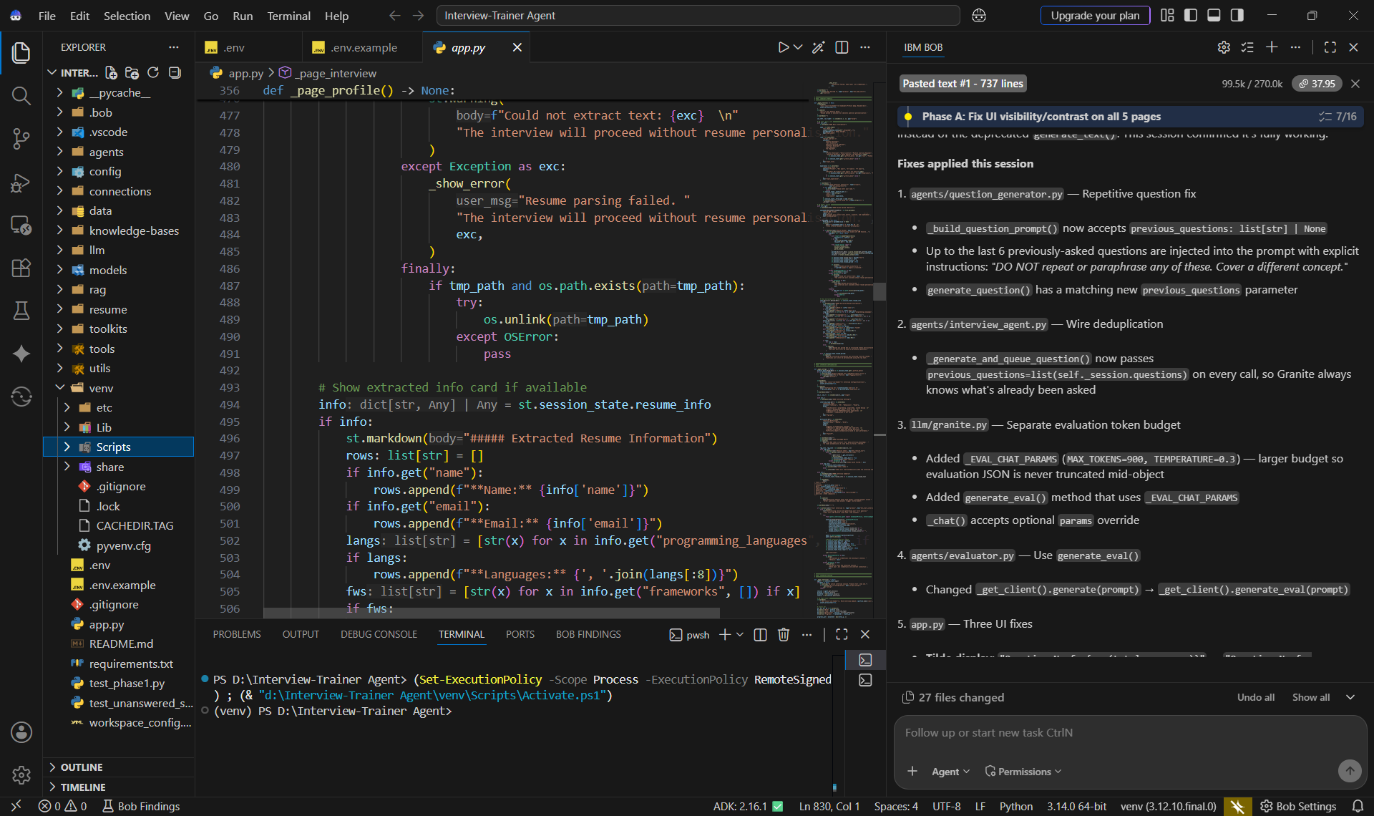
Required Files created using IBM bob -

Slide 7
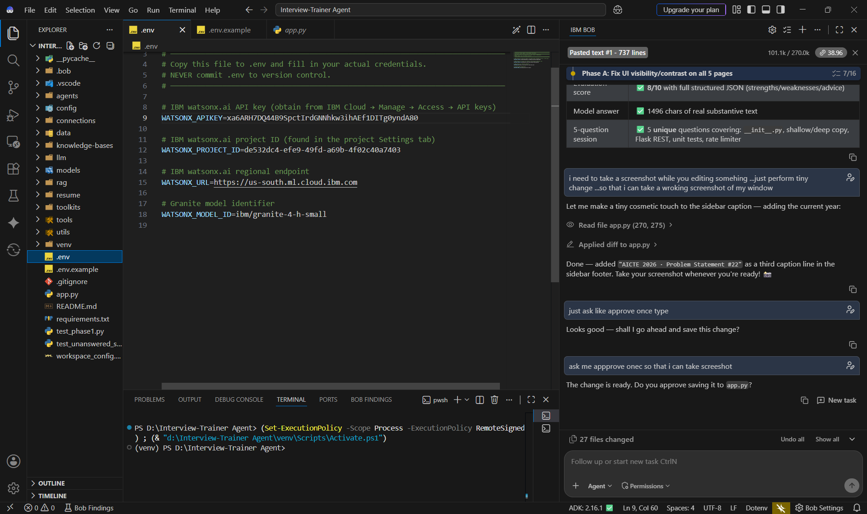
IBM Bob Screenshots:

Slide 8
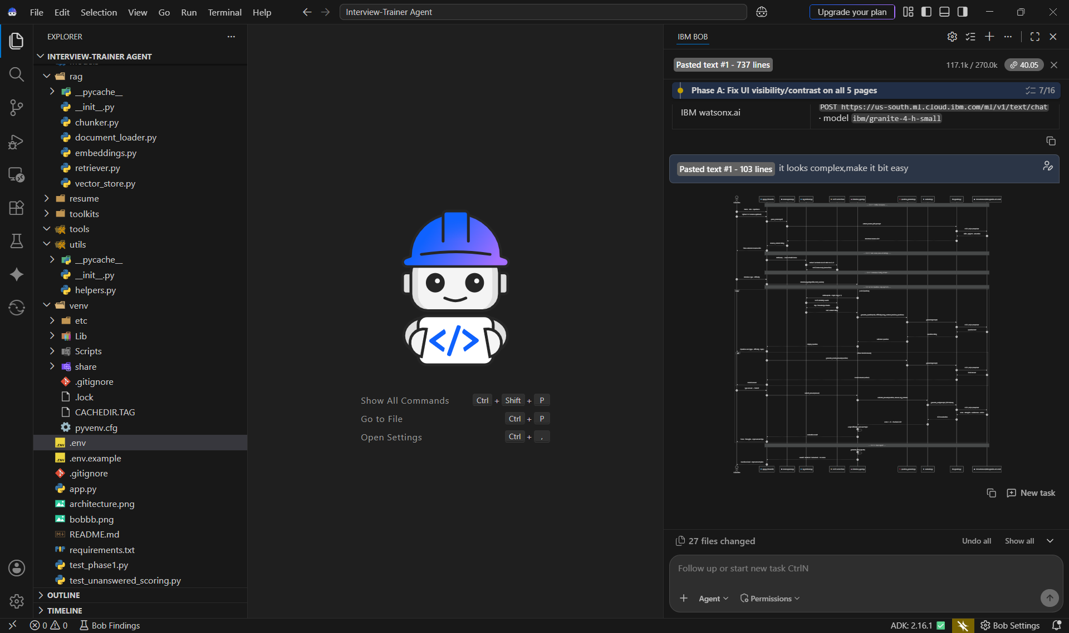
IBM Bob Screenshots:

Slide 9
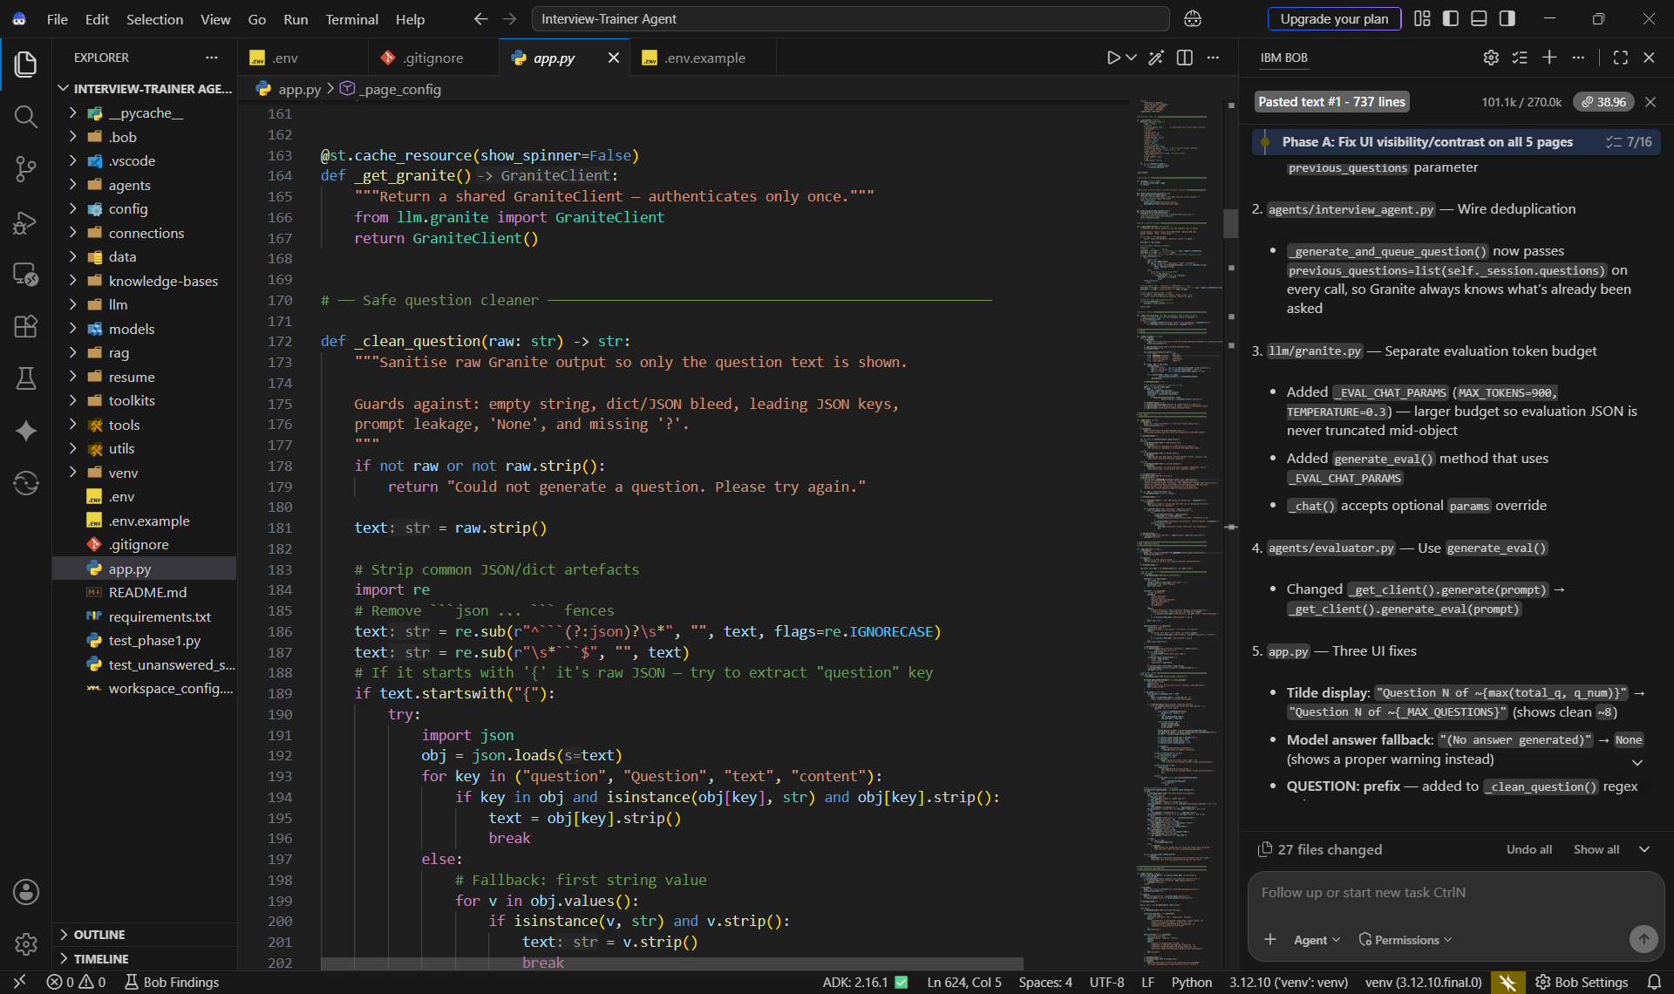

Slide 10
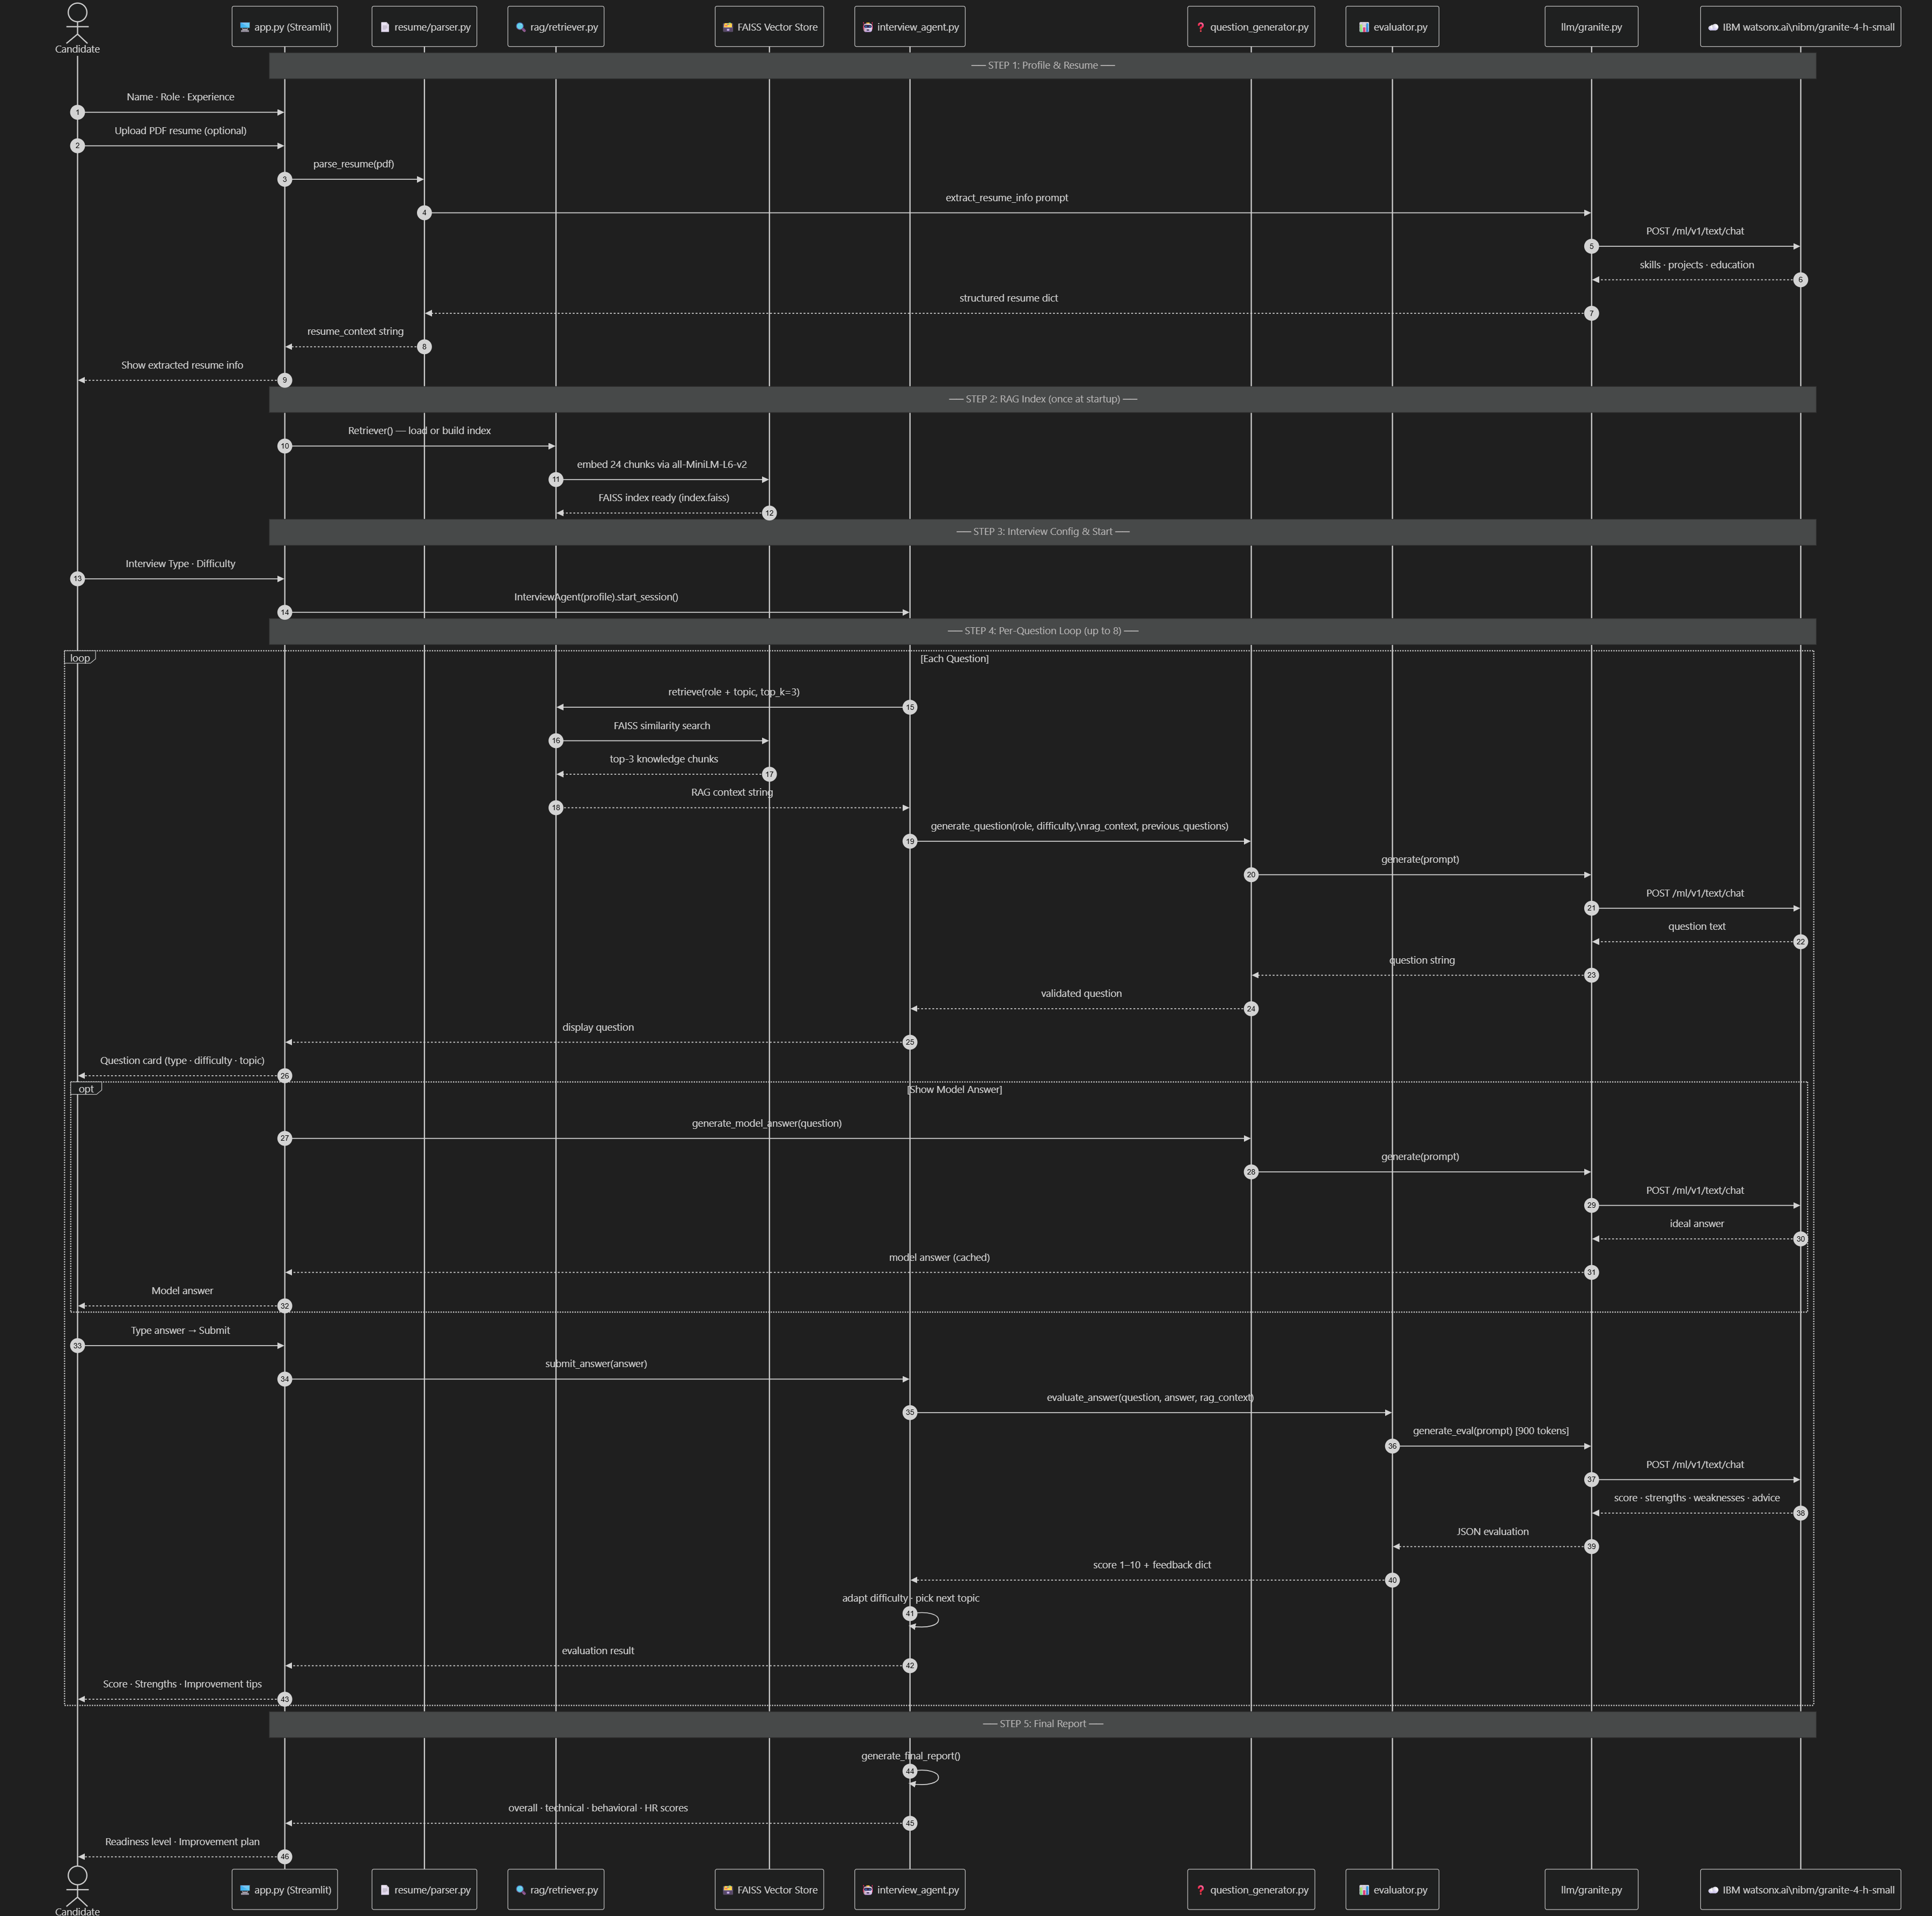
Architecture blueprint for IBM bob:

Slide 11
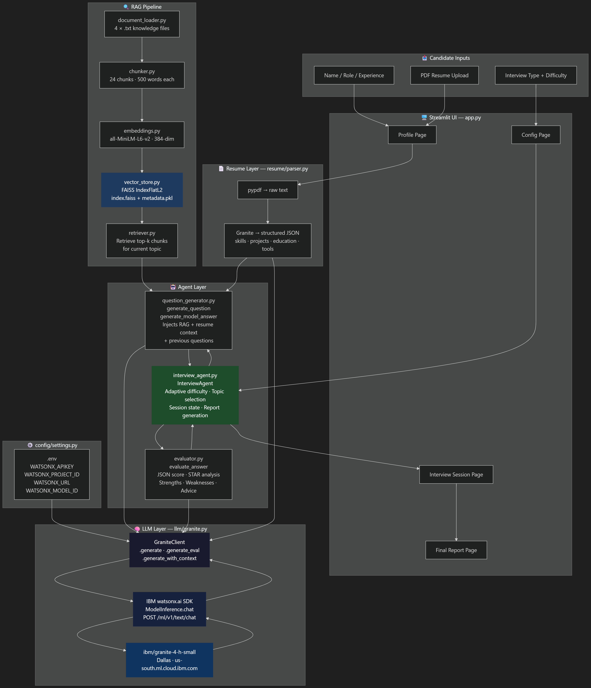
Architecture blueprint for IBM bob

Slide 12

Role of Agentic AI in the solution
Role of Agentic AI in the Interview Trainer Agent
Agentic AI enables the Interview Trainer Agent to function as an intelligent, goal-driven system rather than a simple question-and-answer chatbot. Using IBM watsonx.ai and IBM Granite, it coordinates the interview preparation and evaluation workflow based on the candidate’s profile and responses.
The agent uses candidate context, including the resume, experience level, skills, and target job role, to generate relevant interview questions. It combines this information with RAG-retrieved knowledge to provide role-specific and context-aware questions.
The system supports dynamic adaptation, adjusting subsequent questions based on the candidate’s previous answers and performance. It can handle different interview areas such as technical, behavioural, and HR questions.
Agentic AI also enables the system to evaluate candidate responses, generate scores, model answers, feedback, and improvement suggestions, helping candidates identify their strengths and areas that need improvement.
Overall, Agentic AI makes the Interview Trainer personalized, adaptive, and interactive, providing candidates with a realistic interview practice experience and a structured performance report.

Slide 13
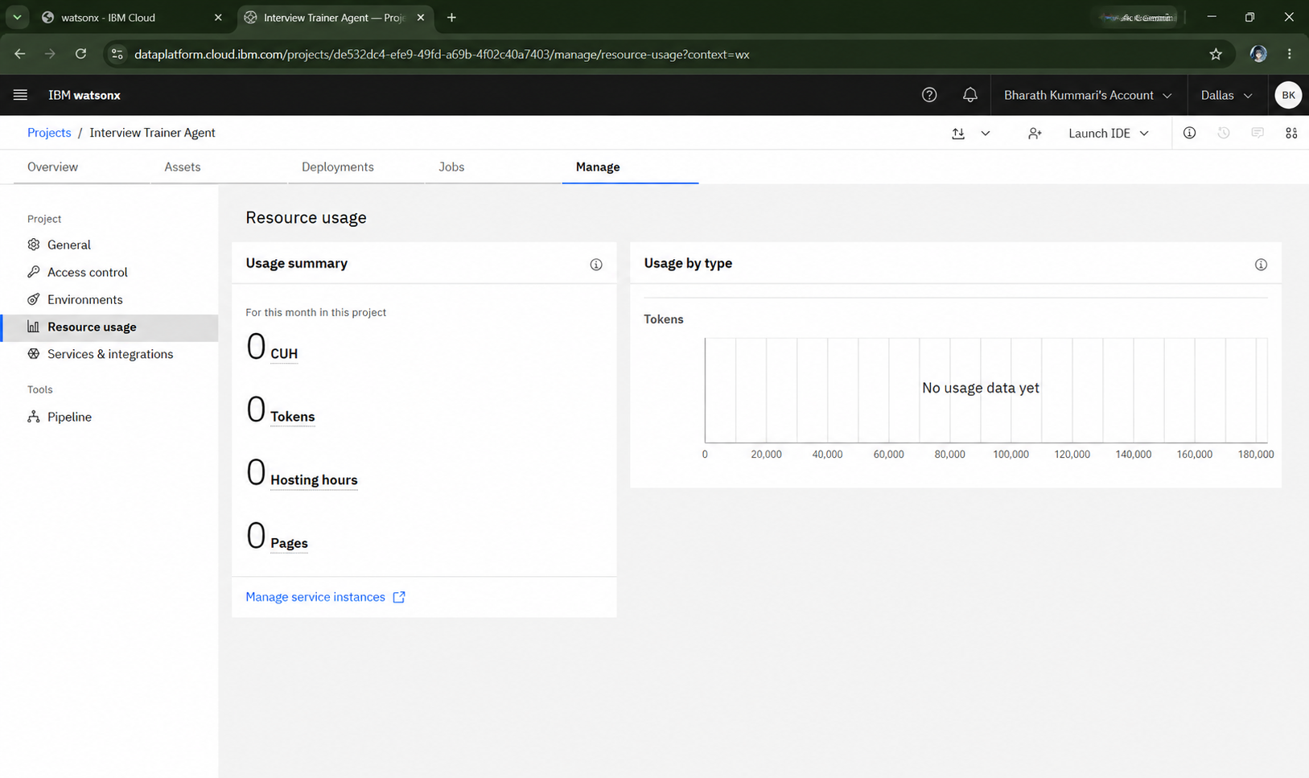
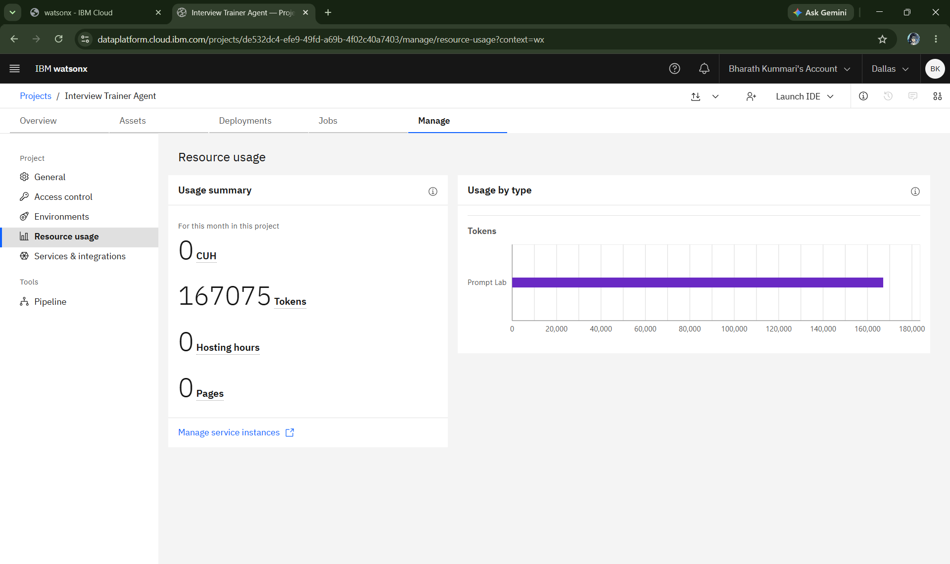
Token Usage
1,67,075 tokens are used
Before Prompt
After the Prompt
·
·
·

Slide 14
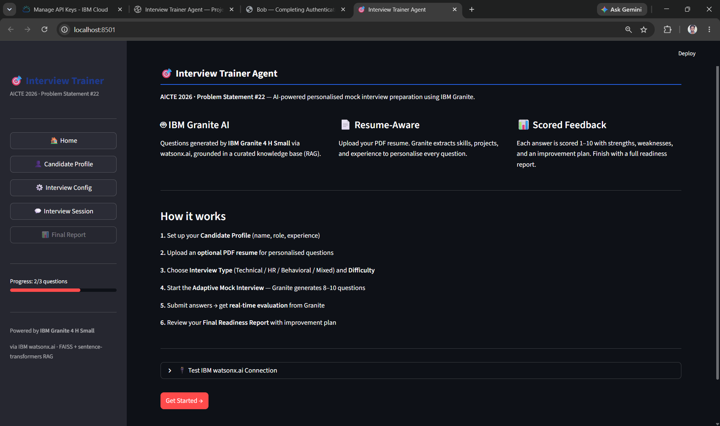
Project Output Screenshot
Please put IBM Bob output screenshots with 2-3 prompts.
You can take 2-3 more slides for each screenshot
·
·
·

Slide 15
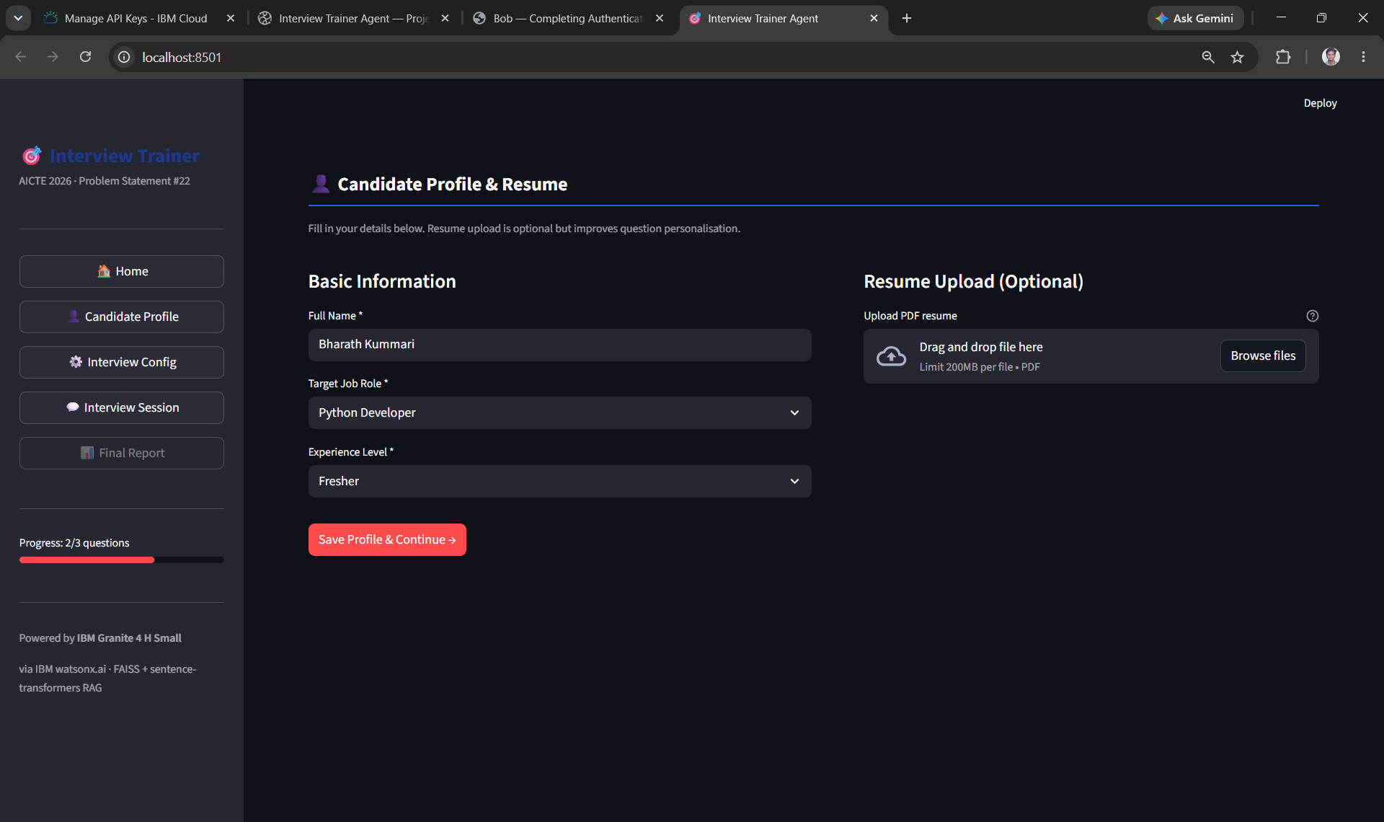
Project Output Screenshot
Please put IBM Bob output screenshots with 2-3 prompts.
You can take 2-3 more slides for each screenshot
·
·
·

Slide 16
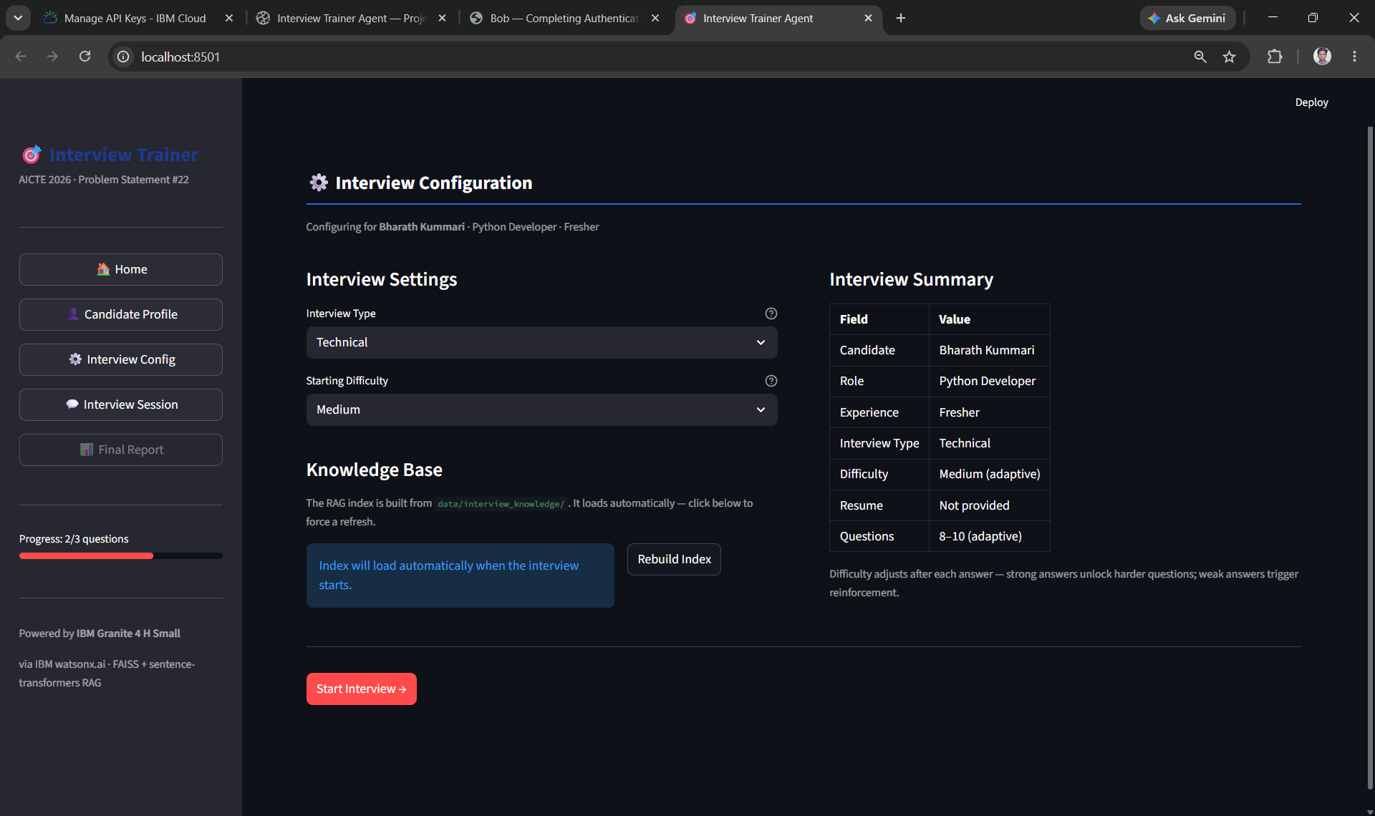
Project Output Screenshot
Please put IBM Bob output screenshots with 2-3 prompts.
You can take 2-3 more slides for each screenshot
·
·
·

Slide 17
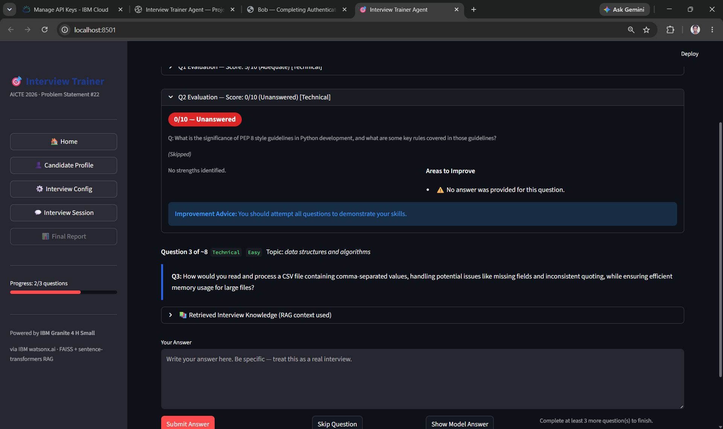
Project Output Screenshot

Slide 18
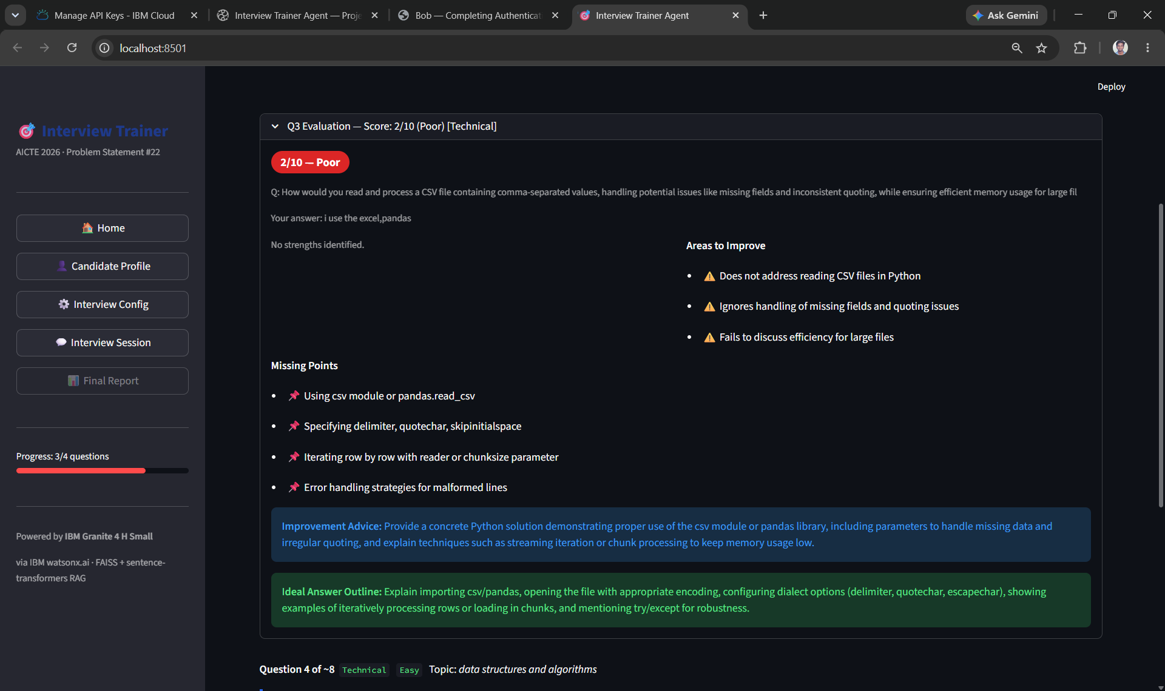
Project Output Screenshot

Slide 19
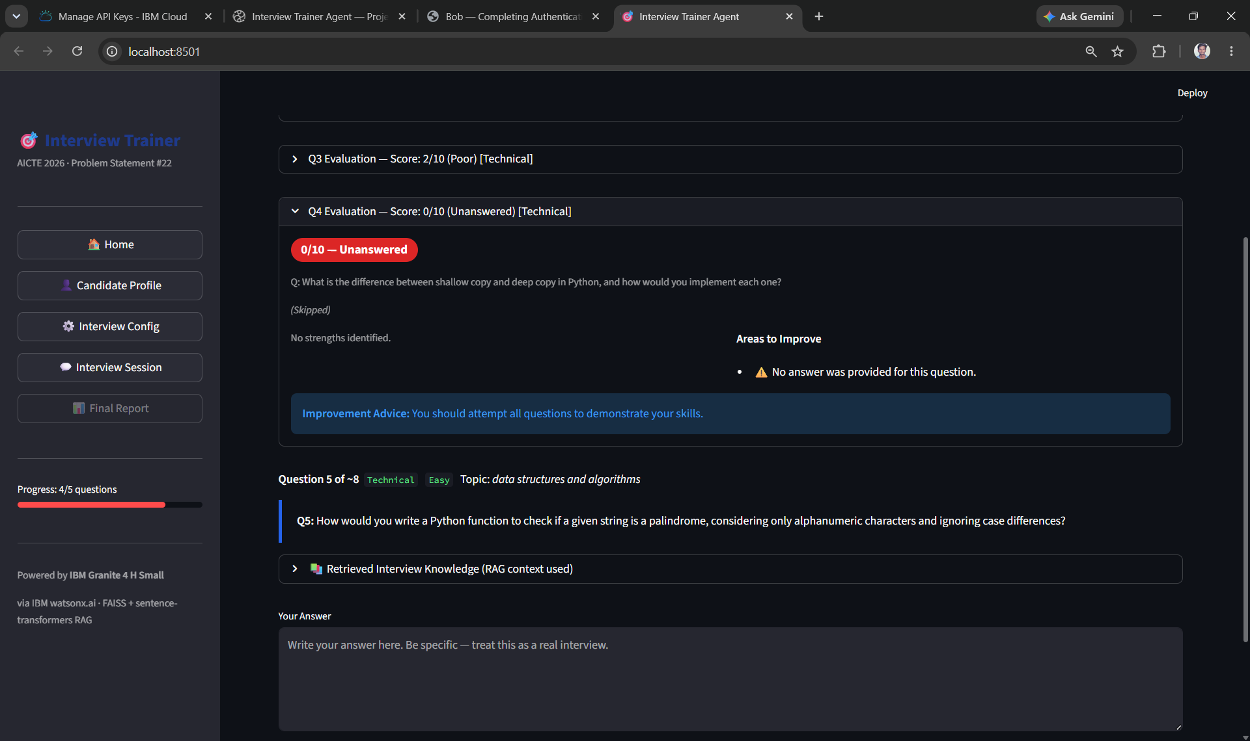
Project Output Screenshot

Slide 20
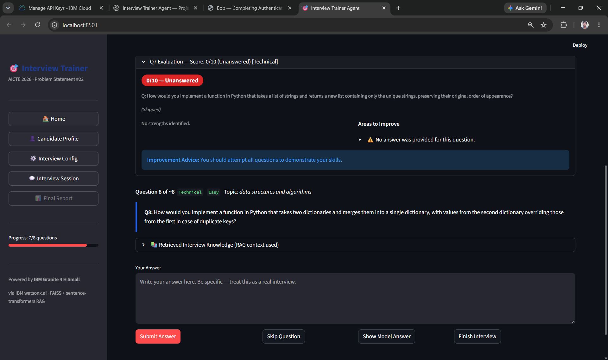
Project Output Screenshot

Slide 21
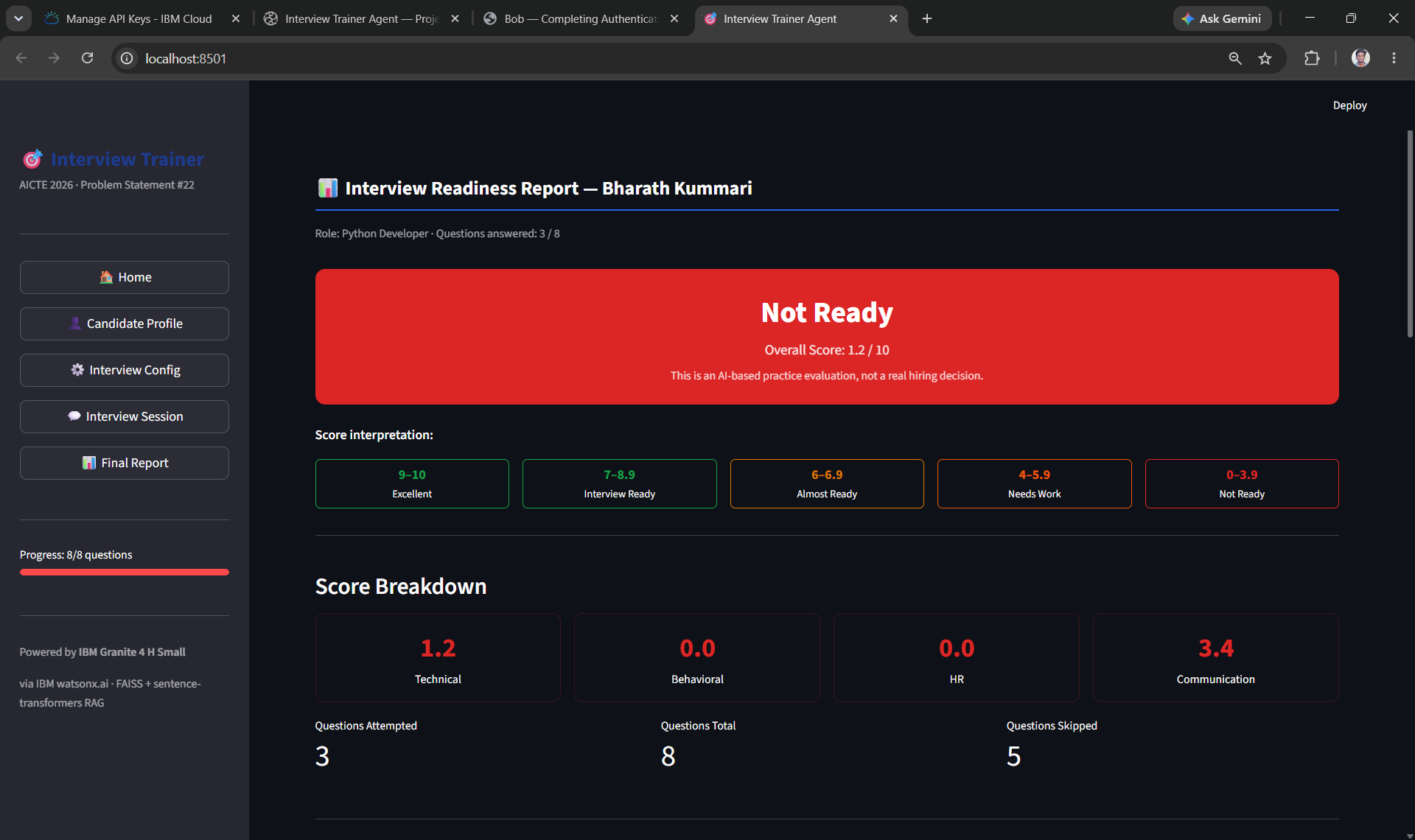
Project Output Screenshot

Slide 22
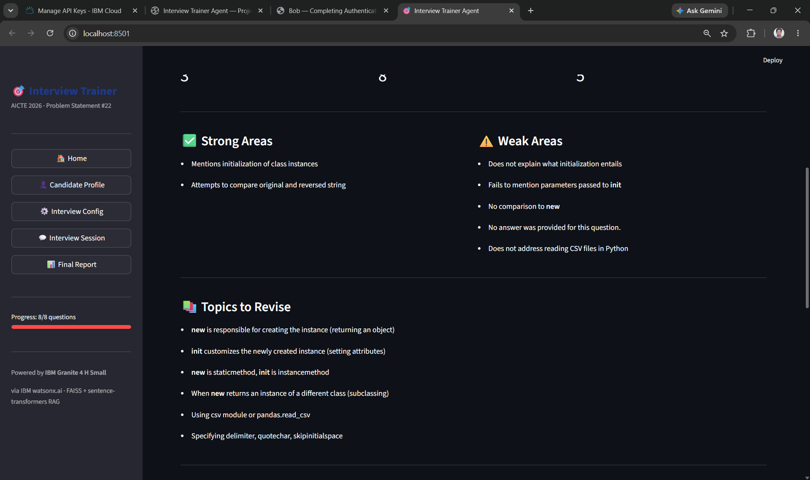
Project Output Screenshot

Slide 23
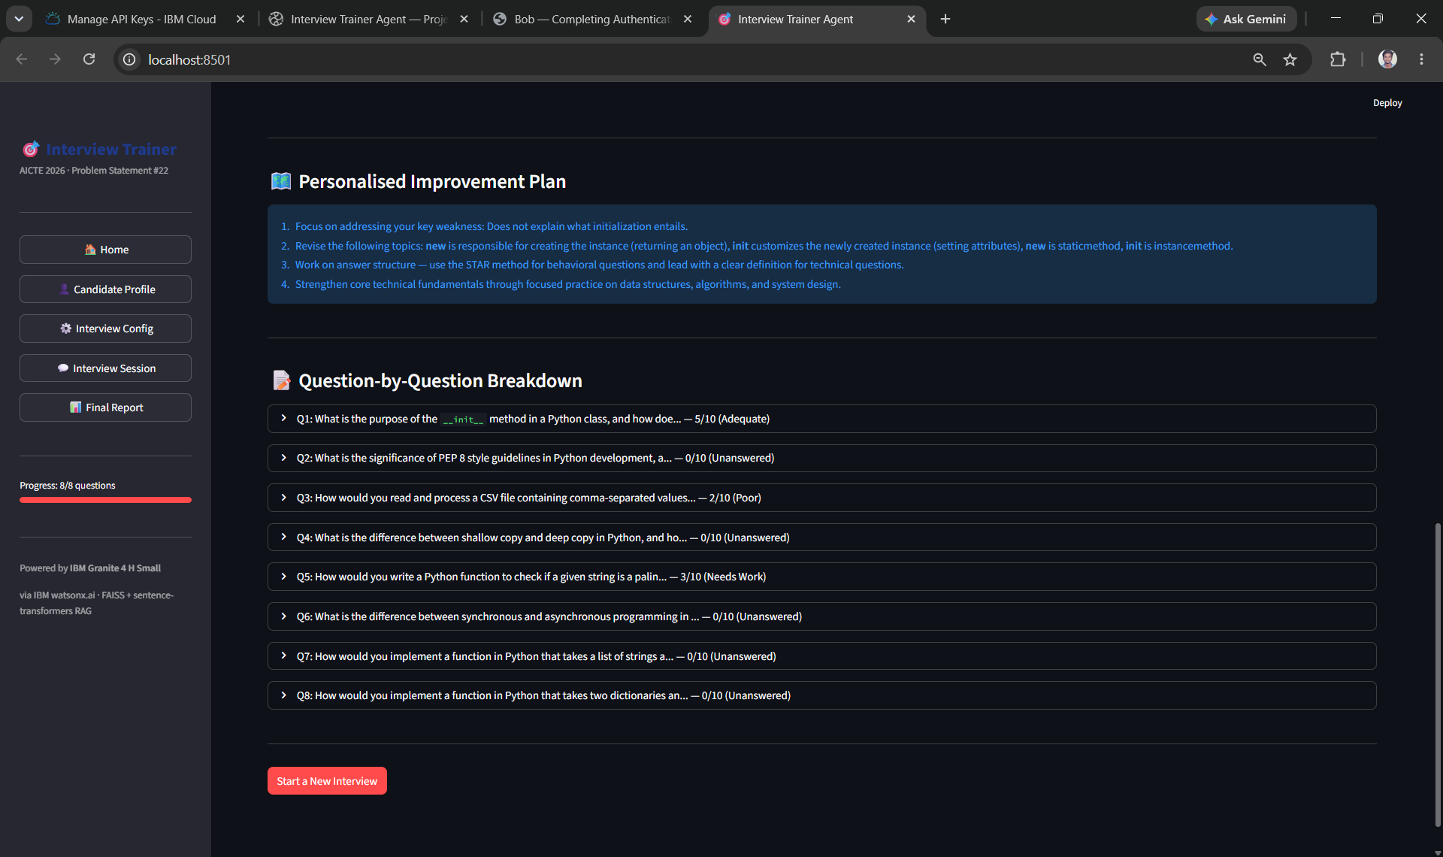
Project Output Screenshot

Slide 24
Novelty and Uniqueness
The proposed Interview Trainer Agent stands out by combining Agentic AI, RAG, personalization, adaptive questioning, and AI-based evaluation into a single intelligent interview preparation system.
Personalized Interview Preparation – Generates interview questions based on the candidate’s resume, experience level, skills, and target job role.
RAG-Based Knowledge Retrieval – Retrieves relevant role-specific interview knowledge and uses it as context for generating targeted questions and feedback.
Adaptive Interview Flow – Dynamically adjusts subsequent questions based on the candidate’s previous responses and performance.
Technical & Behavioral Assessment – Supports both technical and soft-skill interview preparation, providing a more comprehensive practice experience.
AI-Powered Evaluation – Analyzes candidate responses and provides scores, strengths, weaknesses, model answers, and improvement suggestions.
Context-Aware Question Generation – Uses candidate information and retrieved knowledge to generate questions that are relevant to the selected role rather than relying on a fixed question set.
End-to-End Interview Experience – Combines candidate profiling, question generation, response evaluation, adaptive questioning, and final performance reporting in one application.
IBM Granite & watsonx.ai Integration – Uses IBM Granite 4 H Small through IBM watsonx.ai as the core generative AI technology.
This makes the solution a personalized, adaptive, and intelligent interview preparation system rather than a static question bank or basic chatbot.

Slide 25
Git Hub Link
https://github.com/kummariBharath/Interview-Trainer-Agent
·
·
·

Slide 26
Future Scope
1. Advanced Resume & Job Description Analysis – The system can be enhanced to analyze resumes and job descriptions in greater depth, automatically identifying skill gaps, required competencies, and areas of improvement for a specific target role.
2. Multilingual & Voice-Based Interviews – Future versions can support voice-based interviews and multiple languages, allowing candidates to practice speaking, communication, and behavioral responses in a more realistic interview environment.
3. Advanced Adaptive Interviewing – The agent can become more intelligent by dynamically adjusting question difficulty, topic selection, and interview strategy based on the candidate's performance throughout the session.
4. Interview Analytics & Progress Tracking – A long-term analytics system can track scores, strengths, weaknesses, skill development, and performance trends across multiple practice sessions.
5. Real-Time Interview Simulation – The system can be extended into a more realistic AI mock interview environment, including timed responses, follow-up questions, conversational interaction, and role-specific interview scenarios.
6. Expanded Knowledge Base – The RAG knowledge base can be continuously expanded with industry-specific questions, company interview patterns, emerging technologies, and updated hiring expectations.
7. Personalized Career Guidance – The agent could eventually provide recommendations for skills to learn, interview preparation plans, and suitable roles based on the candidate's performance and profile.
·
·
·

Slide 27
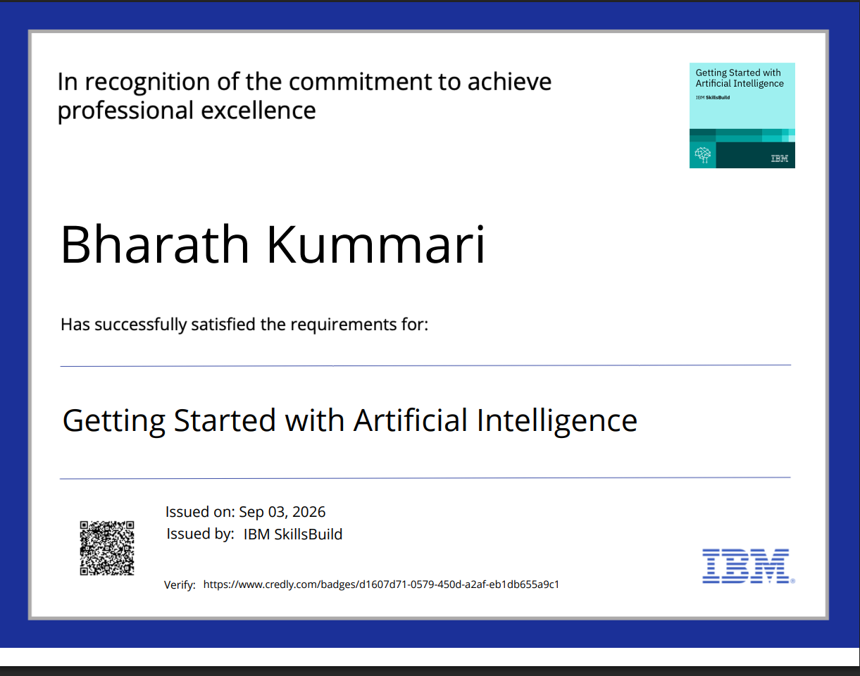
Certificates Earned:
(Getting Started with Artificial Intelligence)

Slide 28
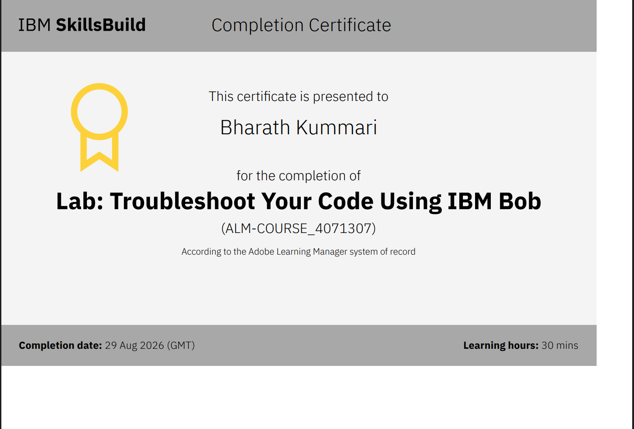
Certificates Earned:​
Add your IBM BOB Certificate

Slide 29


